Slide 1


Design And Implementation Of Library Information Management System
Presented by: Monish L [1972260035]
Aman Singh S [192460117] CSA0206 - C Programming
Date: 22/08/2026

Slide 2
Introduction
The project focuses on utilizing C Program for managing Books inventory and Member records.
Traditional library management system require manual entries which is time consuming and not reliable.
Purpose of the project is to automate the traditional method into reliable machine automated system.

Slide 3
Objectives
Digitalize the tracking of book inventory and member records.
Create a reliable logic system for issuing books, processing returns, and enforcing borrowing limits.
Manual library management relies on paper ledgers, leading to slower search, data entry errors, and inefficient tracking of members.
A robust, memory-safe application with instant data retrival using optimized search and sort algorithms.

Slide 4
Literature Review
S.NO | RESEARCH PAPER | AUTHOR | ADVANTAGES | DISADVANTAGES | TECHNOLOGIES USED
1 | Big Data Analytics in Library Services With AI: Personalized Content Recommendation and Catalog Optimization | Pinijia Hu, Yichi Zhang | Superior Recommendation Accuracy, High Scalability | Data Dependency, Lack of Deep Semantic Understanding | Variational Autoencoder(VAE), Adam Optimizer with Lockhead Mechanism and Large-Scale Data Processing
2 | Path Planning of Library Management Robot Based on PDO – ACO algorithm.(2025) | Na Lin | Massive Efficiency Gains, Reduced Redundancy and High Adaptability | Algorithmic Complexity, Parameter Sensitivity, Real-Time Processing Constraints | ACO(Ant Colony Optimization), PDO(Particle Differential Optimization and Negative Feedback Mechanism)
3 | Information Security and Risk Control Model Based on Plan-Do-Check-Action for Digital Libraries | Yimin Yin | High Accuracy and practical validation | Computational Overhead and Implementation Complexity. | Machine Learning Algorithms

Slide 5
Methodology
Programming language used : ANSI C (C89/C99 standard)
Compiler used : GCC(GNU Compiler Collection)
Development environment: Visual Studio Code/ Code::Block
Development approach: Modular, procedural top-down design
Data collection : CLI-based sanitized input stored persistently in binary .dat files

Slide 6
















System Architecture Design
Student
Get Book
Book Shelf
List of Authors
Find Book Position
List of Titles
Display
Update List of Borrowed Books
List of Borrowed Books

Slide 7








Module 1: Books Inventory & Report Analysis Management
Member
Manage Transaction / Payments
Book Inventory Management Module
Book Management
Stock Tracking & Alerts
Database Book & Inventory
Manage Member Information
Order & Supply Management
Search & Reporting

Slide 8
Module 2 : User information & Circulation Management
User Client
Notification
Service
Authentication Service
Server
Admin Dashboard
Database
Request Queue

Slide 9
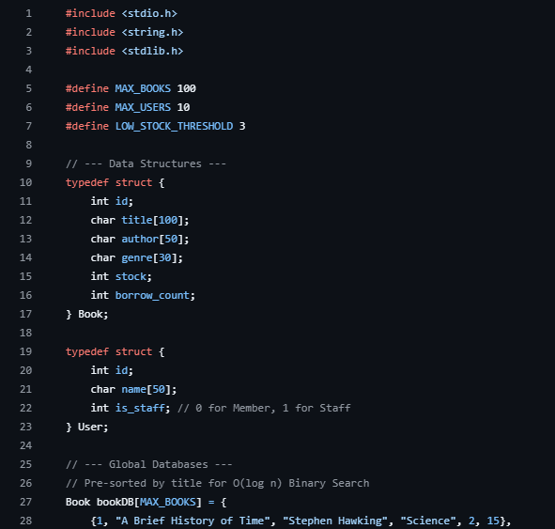
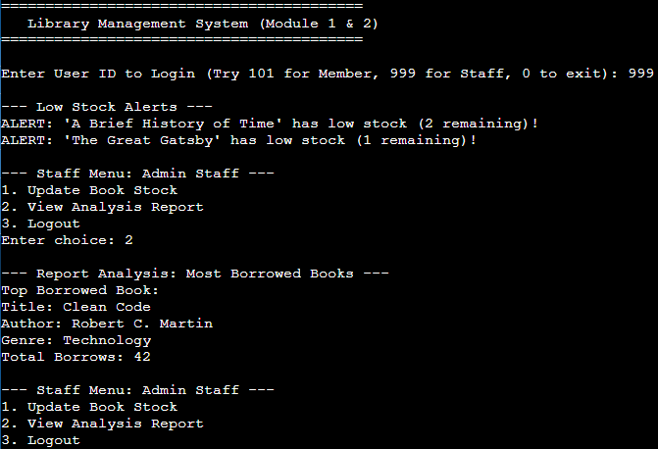
Implementation – Module 1
Books inventory & Report Analysis Management

Slide 10
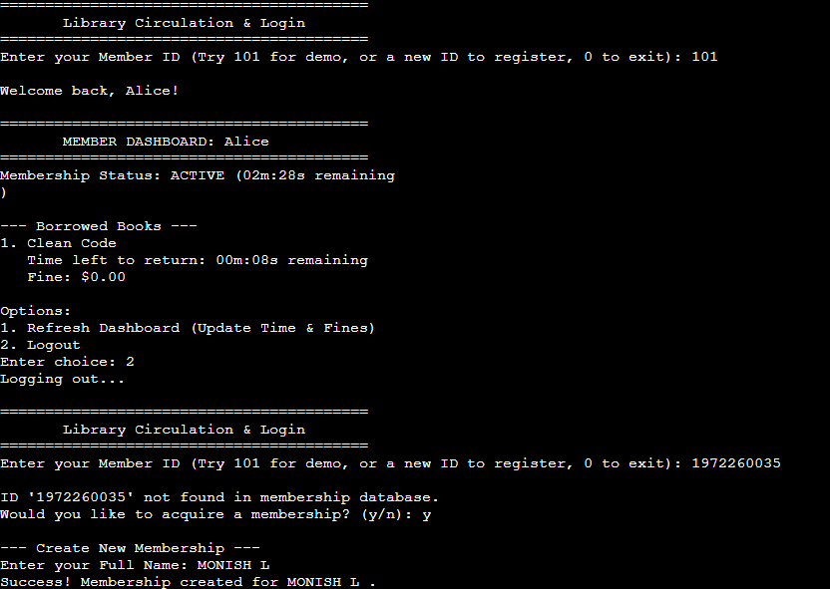
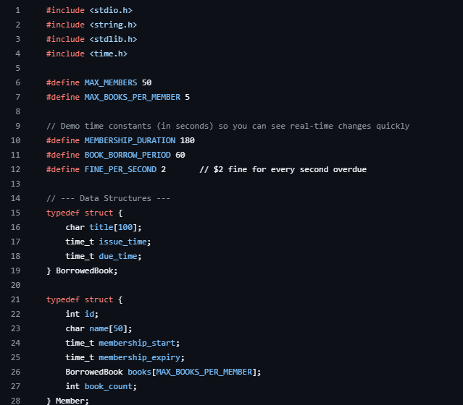
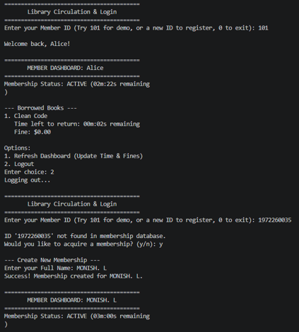
Implementation – Module 2
User information & Circulation Management

Slide 11
Results & Discussion
Search efficiency: Achieved O(log n)retrieval speeds using binary search algorithms, making catalog queries near- instantaneous.
Data persistence: Successfully implemented .dat binary serialization, ensuring 100% data retention.
Resource optimization: Dynamic memory allocation via pointers kept the application footprints exceptionally lightweight.

Slide 12
Challenges & Limitations
Concurrency issues: Raw C file lacks native multi-threading, restricting the system to a single user at a time.
Data corruption risks: A sudden system crash or power loss during an active fwrite operation can permanently corrupt the file.
Security vulnerability: Local binary files(.dat) lack advanced database encryption, making them susceptible to unauthorized local tampering or deletion.

Slide 13
Future Scope
AI & Personalization: Integration of AI recommendation engines to suggest books based on reading history, along with AI chatbots for instant patron support.
IoT & Smart Tracking: Adoption of RFID, IoT sensors, and smart shelves for real-time inventory tracking, self-checkout, and automatic book misplaced detection.
Mobile-First Integration: Mobile apps enabling QR/barcode self- scanning, digital library cards, push notifications for due dates, and remote renewals.

Slide 14
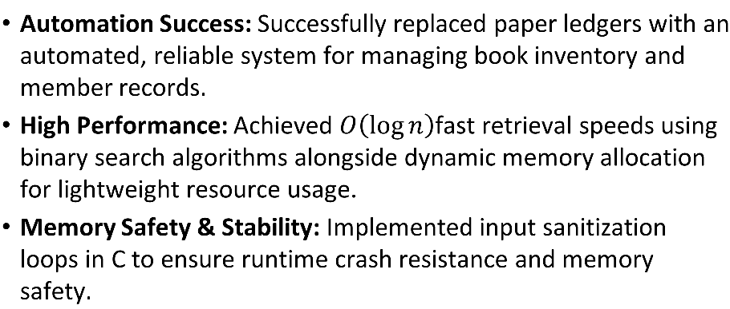
Conclusion

Slide 15
References
N. I. Ismayilov, "Library resources: Allocation and usage problems (comparative analysis of the world and regional practice)," Scientific and Theoretical Almanac Grani, vol. 26, no. 1, pp. 38-43, 2022.
N. I. Ismayilov, "Library resources: Allocation and usage problems (comparative analysis of the world and regional practice)," Scientific and Theoretical Almanac Grani, vol. 26, no. 1, pp. 38-43, 2022.
N. Khalilova, "The importance of scientific research on document management," Akademik Tarih ve Düşünce Dergisi, vol. 11, no. 6, pp. 4628-4634, 2024.
N. Khalilova, "A general perspective on a digital bibliographer as an element of an electronic bibliography," Akademik Tarih ve Düşünce Dergisi, vol. 11, no. 4, pp. 2687-2696, 2024.
I. Nadir and K. Sevda, "General characteristics of local lore documental network resources of the libraries of Azerbaijan (based on library collection)," Technium Soc. Sci. J., vol. 33, p. 628, 2022.

Slide 16
Thank You!
Any Questions?

